Slide 1


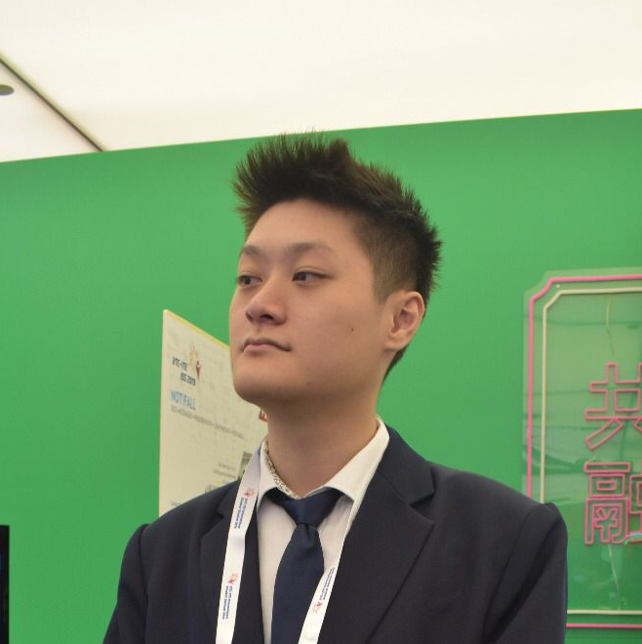

TOMOWORK GOAL SETTING WORKSHEET
NAME
Willie Lee
INSTITUTE
Republic Poly
GOAL START DATE
20 MARCH 2023
GOAL COMPLETION DATE
1 JUNE 2023
MY CAREER GOAL IN ___ YEARS
WORK
Drawing, 3D Modeling, Streaming
LEARNING
Unreal Engine 5 Blueprint / 3D modelling and texturing.
ACTIVITIES
Repairing of household material.
5 THINGS I WANT TO ACHIEVE FROM TAP (Please include more than 1 soft skills)
ACTION THAT WILL HELP ME TO REACH MY GOAL
REVIEW
(REVIEW BY 31 MAY MORNING)
1 | Motivation
2 | Courage / Confidence
3 | To work in a company that I am capable of
4 | Obtain qualified certificates
5 | Knowing which company I can join
1 | Communication skills
2 | Time management
3 | Procrastinate less
4 | Having the guts to speak up when needed
5 | Lead by example
1
2
3
4
5
COMMENTS FROM FACILITATORS

